Slide 1


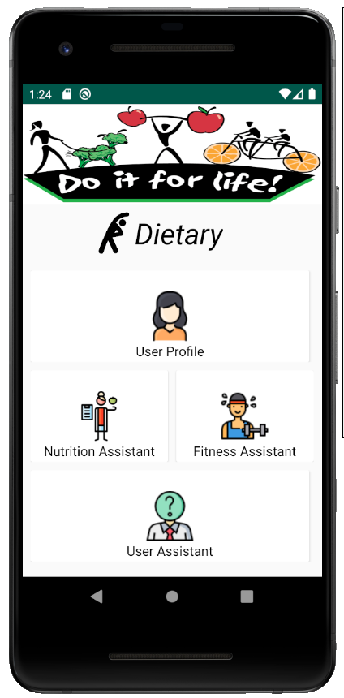
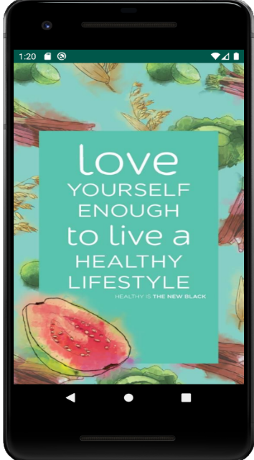
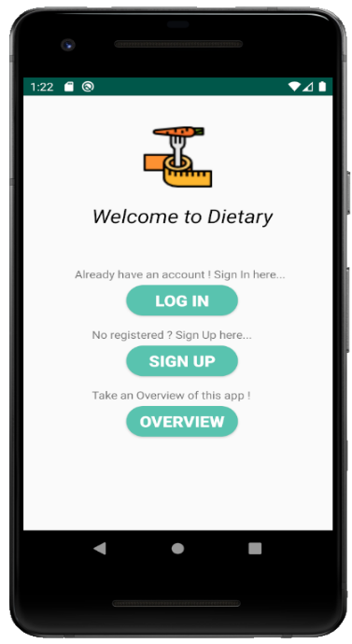
CSE 299 Final Presentation
Dietary: a Cloud-based
Nutriment & Fitness Assistant
(fact-based) Android App for Bangladeshi Youths.
Presenting by : group 1
Date : 24.09.2020

Slide 2


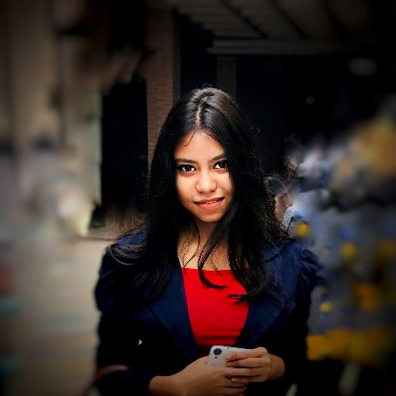
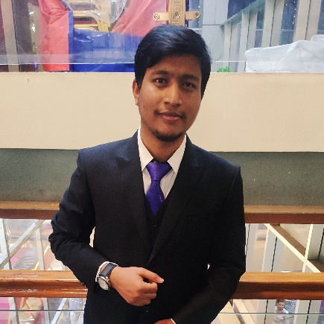

Our Team
Polin Rahman
Md Iftehad Amjad Chy
Ahmed Rifat
ID : 1531377042
ID : 1612547042
ID : 1620746042
Email :
polin.rahman@northsouth.edu
Email :
iftehad.chy@northsouth.edu
Email :
ahmed.rifat@northsouth.edu

Slide 3


Agenda
Introduction
Background Study
Aim & Objective
Application Overview
Result
Future Work
Contribution List
Conclusion
References
Demonstration & Q/A Segment

Slide 4

Introduction
Nowadays the mobile phone is the most serviceable device.
In the field of the operating system, Android is on thriving growth with the suitability of cloud computing.
Cloud service enables remote resources, saving organizations the cost of servers and other equipment.
A chatbot is an artificial intelligence (AI) software that can simulate a conversation with a user in natural language through messaging applications. It help users to obtain timely and efficient assistance or information.
Machine learning technology improves efficiency and accuracy of data processing. ML algorithms more “experience,” to take better decisions or predictions.

Slide 5
Application Introduction
Dietary : a Cloud-based Nutriment & Fitness Assistant (fact-based) Android App for Bangladeshi Youths.
Its mainly a nutrition & fitness guideline providing application.
Its main audience is young people.
Also, focusing on user practical life situations.

Slide 6
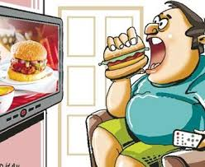
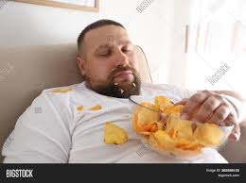
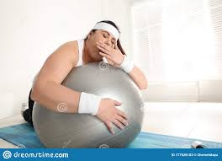

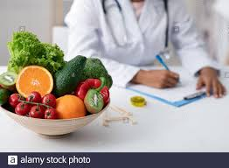


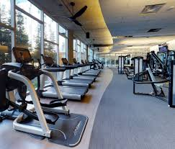
Project Purpose
Some Real facts
Currently Bangladeshi people specially Youths have busy life style, stress, procrastination and so on…….
Unhealthy food habit
Carelessness about fitness
Knowledge gap about health maintenance
Unable to manage Nutritionist or Gym
Poor immunity system
Non-Communicable Diseases (NCDs)

Slide 7



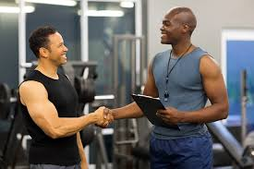
Our Focus
Smart Approach
Mobile App
Our main focus
on Youth's health like
Nutrition
Fitness
Nutritionist Facility :
Health sate, food plan based of requirement, nutrition guideline.
Fitness Coach Facility :
Workout plan on user demand, workout details & guideline.

Slide 8
Background Study
Background Study for project based on 3 part :
Scholarly Articles (Google Scholar)
* 2 articles base on Machine Learning approached in
food recommendation (from last 1 year).
Exiting Similar Work (Android app)
Market Research (current treads on mobile market)
* market priority of Android operating system then IOS.
Google Play
Native app
100K+ download
Rating 4.0+
Comments in 2020

Slide 9
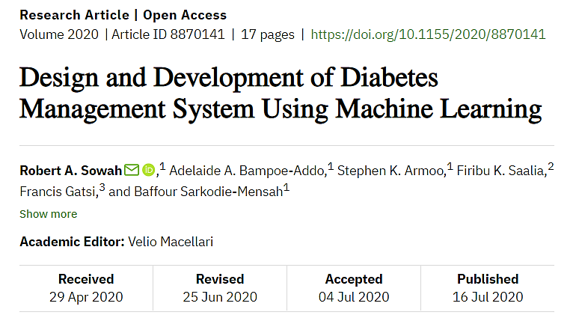
Scholarly Articles
This paper describes a software system to improve the management of diabetes using a machine learning approach.
Used Tensorflow neural network model for food classification.
Used K-Nearest Neighbour (KNN) algorithm to recommend meals.
Also used cognitive sciences to build a diabetes question and answer chatbot.
They claimed this system would solve the problem of managing activity, dieting recommendations, and medication notification of diabetics.

Slide 10
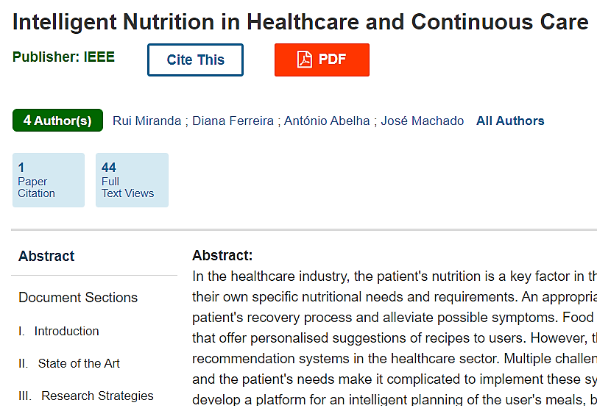
Scholarly Articles
This project aims to develop a platform for an intelligent planning of the user’s meals, based on their clinical conditions.
The application of machine learning algorithms on nutrition, in healthcare services and continuous care is thus a key topic of research.
They use the Design Science Research (DSR) investigation methodology, ensuring that the solution to the problem accomplishes all needs and requirements of the professionals.

Slide 11
Our Observation
Observation from “Scholarly Articles”….
Research based work with mobile application is very minimum.
In case of food/nutrition/health; some AI based approach's like food recognition using Deep Learning, food recommendation using Machine Learning & Chabot for Q/A.
So we decided to apply;
Machine Learning approach using KNN for food recommendation & Chabot for Q/A or guideline.

Slide 12
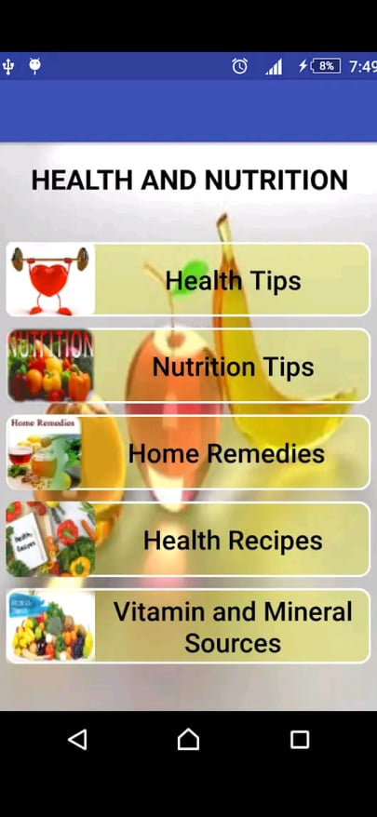
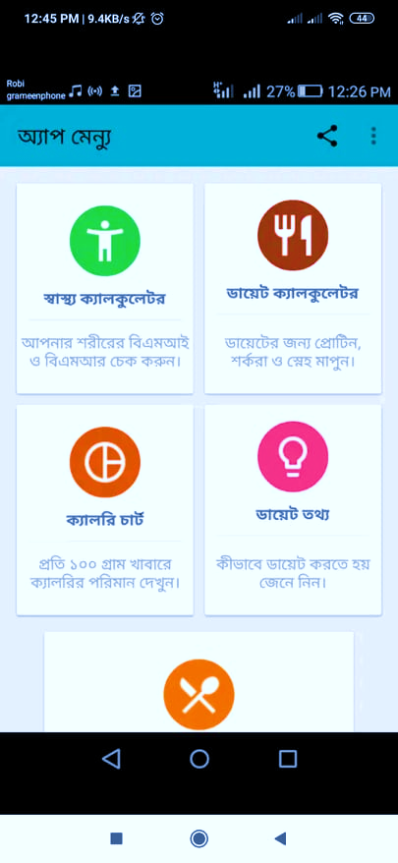
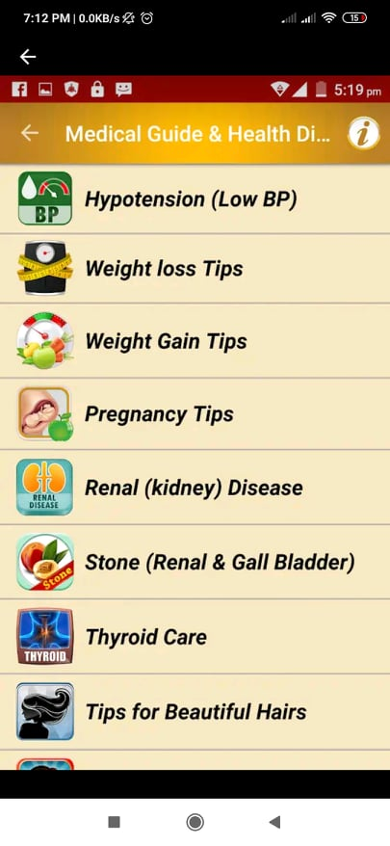
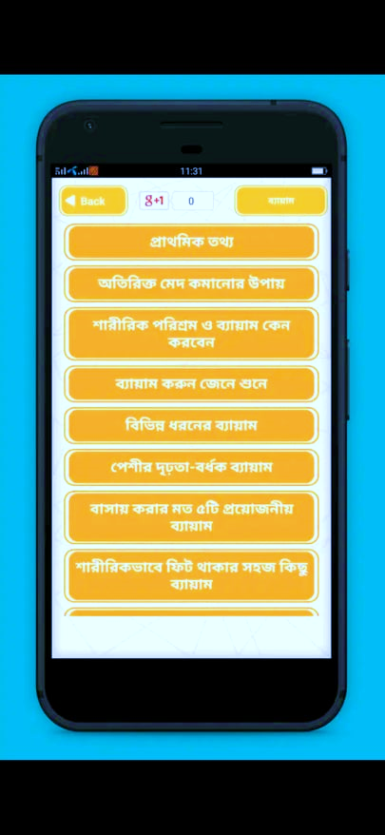
Existing Similar Work
Health and Nutrition
Calorie and Diet
Healthy Diet foods & Fitness Help
Physical Exercise
4.6
4.2
4.5
4.4
Contains tips like health, nutrition, home remedies.
Food recipes.
Vitamin sources.
Full of tips like weight gain & loss, home remedies.
Information about diseases.
Beauty & lifestyle tips.
Workout guideline on different section.
Workout details.
Fitness tips.
Workout related basic information .
Contains BMI, BMR & diet calculator.
Calorie chart.
Diet Guideline.
Food recipes.

Slide 13
Our Observation
We choose 4 apps (rating : 4.2+) by our native developers.
So, we observed..
Majority of them for nutrition guideline app.
Nutrition & fitness not in a single app.
All are mostly static guideline/tips providing app.
Not mentioned guideline/tips sources.
So we decided to build;
A single app with both “Nutrition” & “Fitness” section. Also following
valid source for resources and customize option for all variation of users.

Slide 14
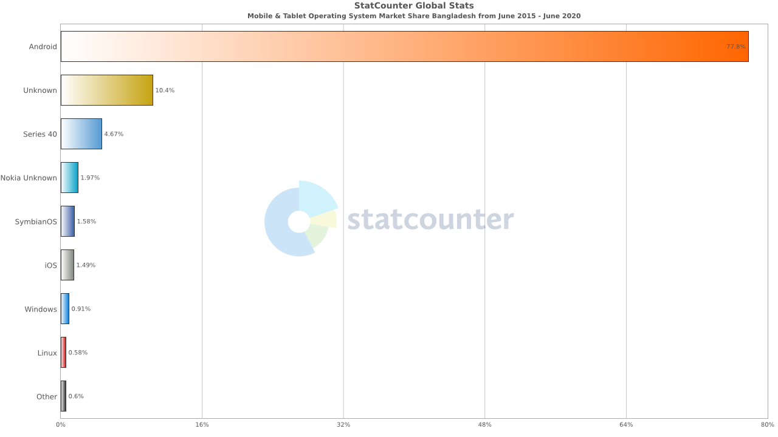
Market Research
Why Android Application ?

Slide 15
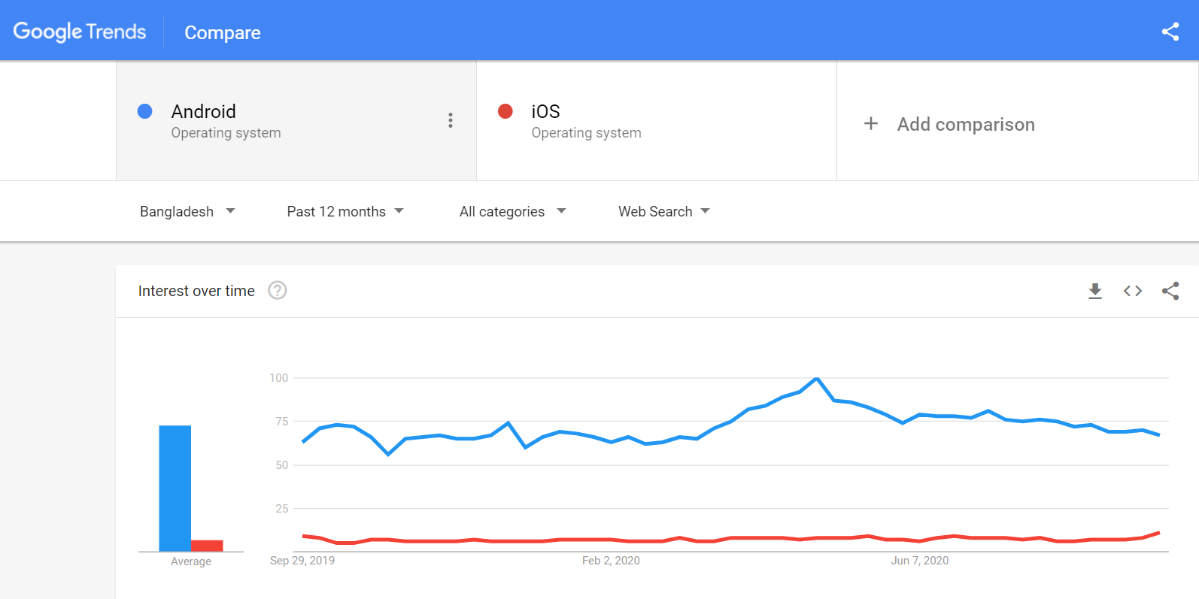
Market Research

Slide 16
Our Observation
In previous 2 slides we observed Android took a very strong place in operating system market.
So, we choose our app development for Android Operating System to reach more end user.

Slide 17
Aim & Objective
Introduce an Android application for Nutrition & Fitness guideline, specially dedicated for Bangladeshi Youths.
Providing Nutritionist & Workout coach through virtual assistant in a single app without any cost.
It’s a fact based app which providing all service based on every type of users.
Using ML approach, chatbot & cloud service (RTD) to develop more dynamic & efficient application.
Using reliable & valid source for resources.

Slide 18
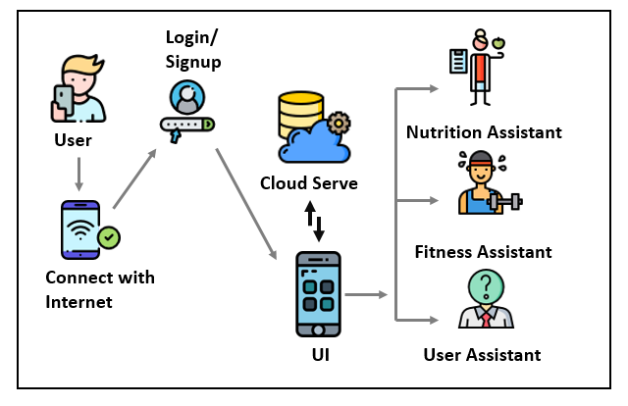





System Overview
Nutrition Assistant
BMI Calculator
Food Recommender
Fitness Assistant
Regular life-based
Busy life-based
User Assistant
Chatbot

Slide 19
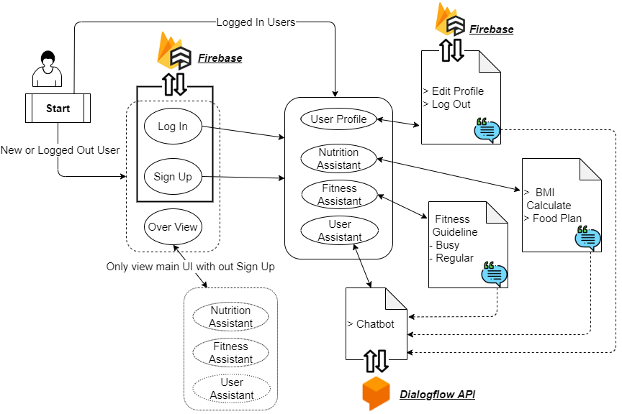
System Architecture

Slide 20
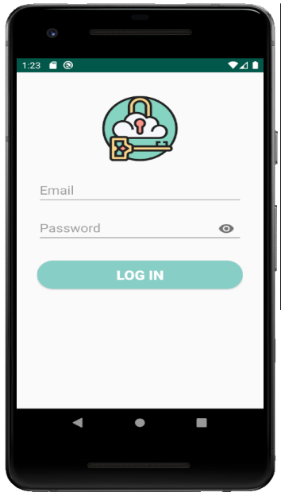
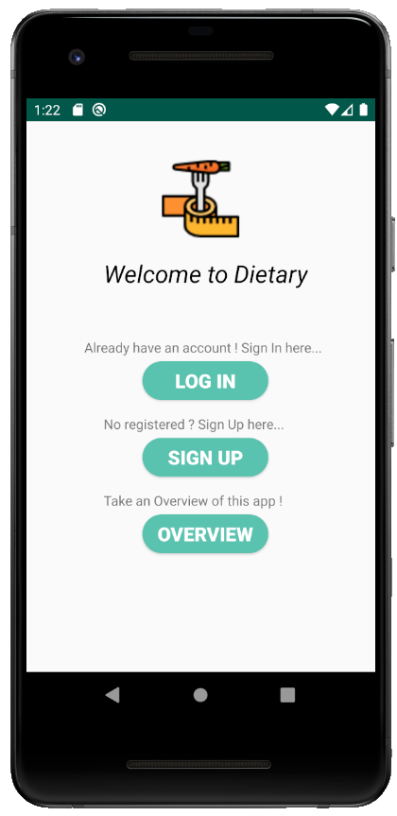
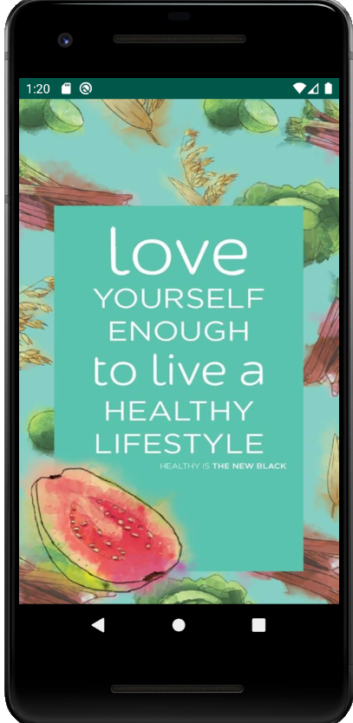
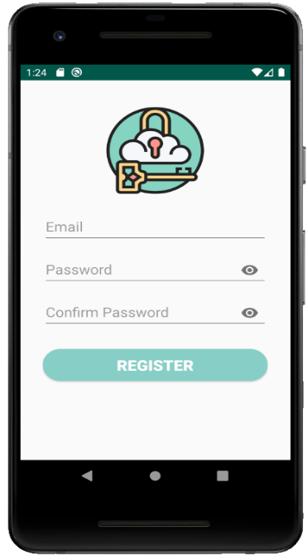
User Interface
Log In Screen
Splash Screen
Options Screen
Main User Interface
Non performable overview of main app
Sign Up Screen

Slide 21
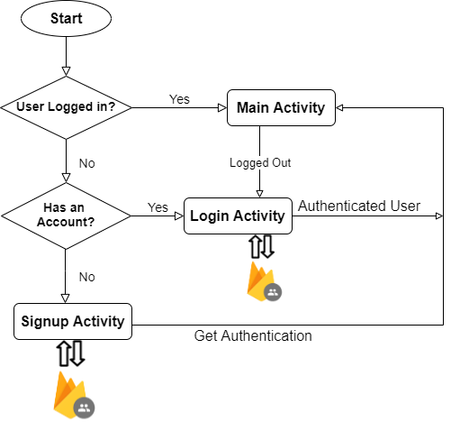
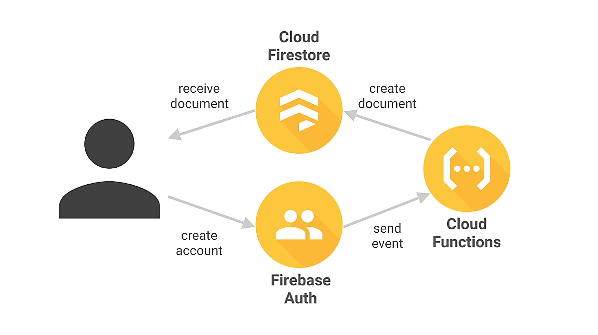
Authentication Flowchart
How Firebase works?

Slide 22

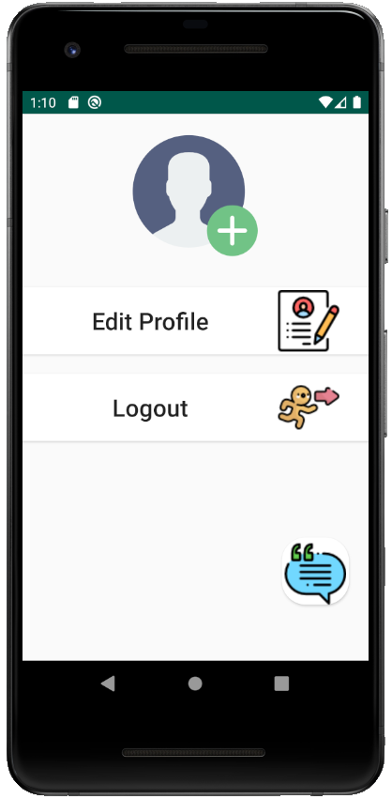

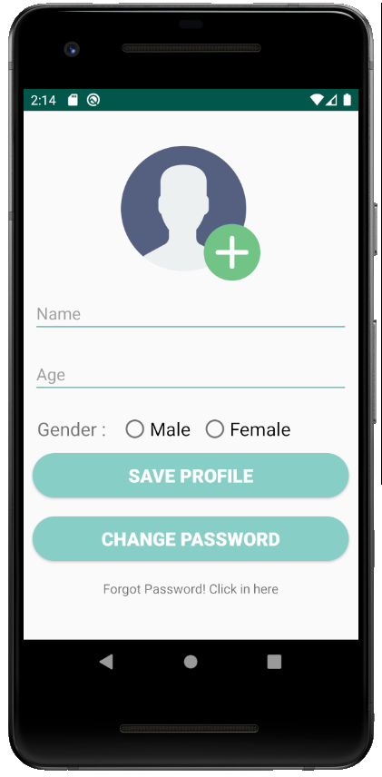
User Profile
Initial plan was basic Authentication.
For more efficiency; we added User Profile option.
Where user can add, edit & update information using cloud Firestore.
Successful logout.
Without logout, app maintain log in state.
Chatbot
for quires.

Slide 23
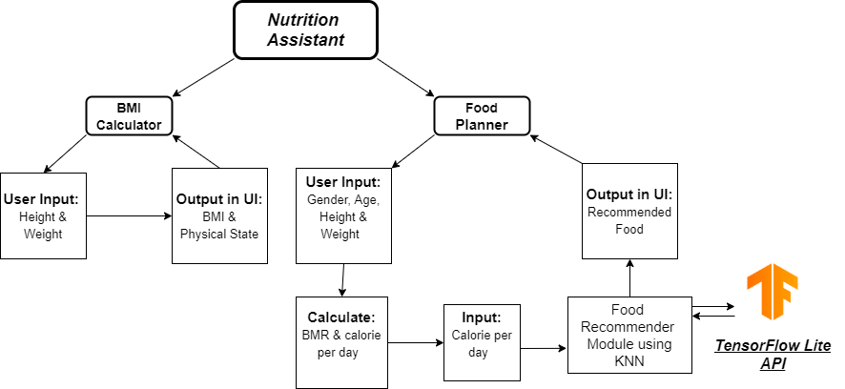
Nutrition Assistant
[Block Diagram]

Slide 24
Dataset Processing
Dataset collected “data.world”
This data is a flattened version of the USDA National Nutrient Database.
This dataset contains 41 features. [ like food group(breakfast, snacks, lunch, etc), their description, and how much kilocalories, carbs, proteins, fats, vitamins, etc.]
We working on 3 Features. [ like food group, description & energy in k/cal. ]

Slide 25
Dataset Processing
Split Data :
for training 80 %
for testing 20%
Input :
Food Group (breakfast, lunch, snacks or dinner)
Kilocalorie
Merge Data :
Breakfast = 200 data
Lunch = 200 data
Snacks = 200 data
Dinner = 200 data
Output :
Food Lists

Slide 26
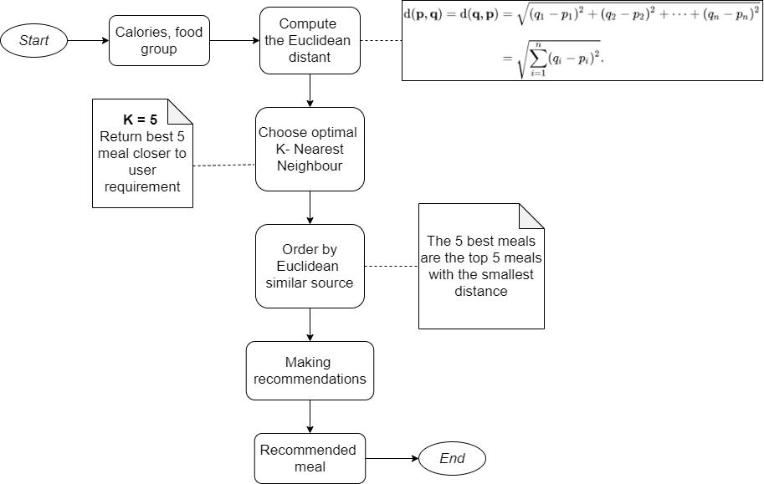
Flowchart for Food recommendation using KNN

Slide 27
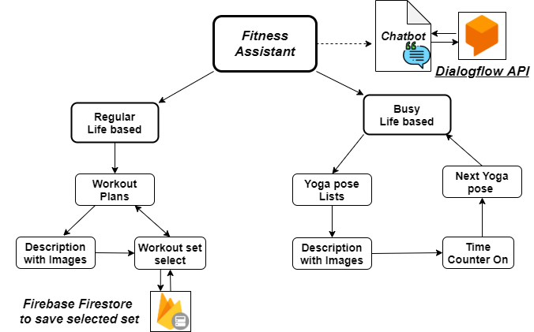
Fitness Assistant
[Block Diagram]

Slide 28
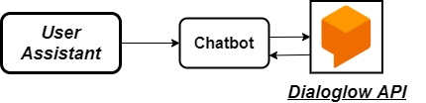
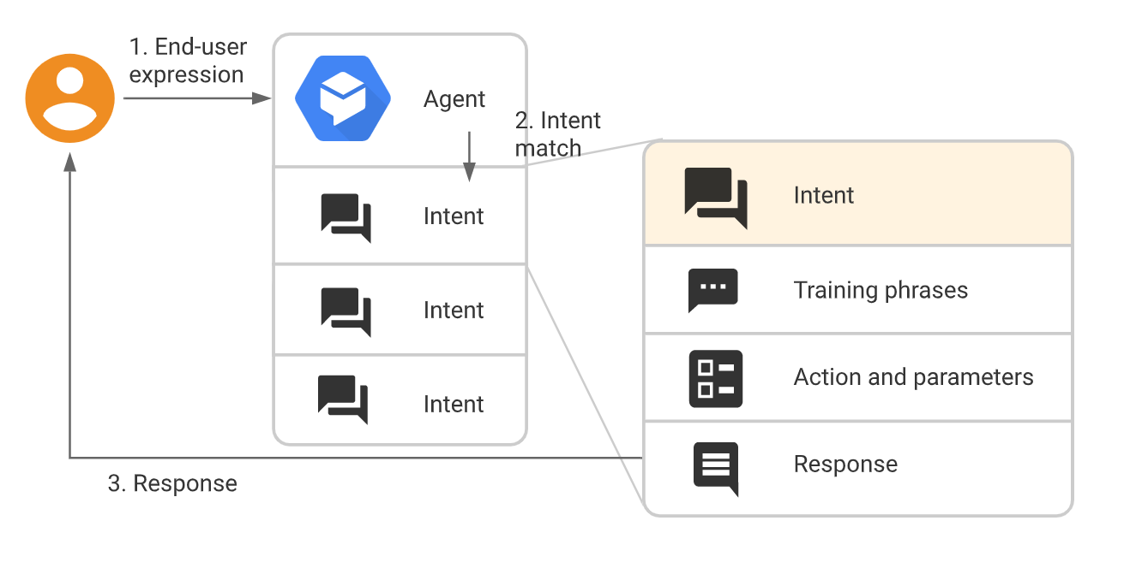
User Assistant
[Block Diagram]
How Dialogflow works?
Chatbot as User Assistant
For user manual
For Q/A
For help or support
Used Dialogflow for Chatbot

Slide 29

Result
Complete | Incomplete
Authentication using Firebase. | Implementation of food recommender.
Full complete two functionality & one functionality with half part | User Profile
API integration for Chatboat
So, we able to manage 70% work done of our project.
ML is a completely new approach, so it require more time for implementation.
Unable to User Profile for 2 reasons -
Later include this part
Run time error :
- 'More than one file was found with OS independent path
META-INF/DEPENDENCIES‘
- Error:Execution failed for task ':app:processDebugManifest'.
Possible solution : configure build.gradle module

Slide 30
Future Work
Implementing full ML based app
Voicebot for better user support
Side navigation bar UI for more better user experiences
Regular notification “Todays Workout Plan”

Slide 31


Our Contribution
Polin Rahman | Md Iftehad Amjad Chy | Ahmed Rifat
User Interface | Yoga poses with clock counter (Fitness Assistant- Busy life base) | Authentication (using Firebase)
BMI Calculator (Nutrition Assistant) | Resources : images, icons etc. | Fitness Assistant- Regular life based.
Dataset collect & process | Mode Train & Implementation | Model Train & Implementation
Model Train & Implementation
Chatbot (User Assistant)

Slide 32
Conclusion
Our future plan is to make this application
a complete ML trained Virtual Assistant.
Our motivation is not replacing real life
Nutritionist or Fitness Instructor.
Our main goal is speared Nutrition & Fitness
related consciousness & guiding among regular
life people through this App.

Slide 33
Thank you!

Slide 34
References
Sowah, R., Bampoe-Addo, A., Armoo, S., Saalia, F., Gatsi, F. and Sarkodie-Mensah, B., 2020. Design and Development of Diabetes Management System Using Machine Learning. International Journal of Telemedicine and Applications, 2020, pp.1-17.
R. Miranda, D. Ferreira, A. Abelha and J. Machado, "Intelligent Nutrition in Healthcare and Continuous Care," 2019 International Conference in Engineering Applications (ICEA), Sao Miguel, Portugal, 2019, pp. 1-6, doi: 10.1109/CEAP.2019.8883496.
Health and Nutrition - Apps on Google Play. (n.d.). Retrieved September 23, 2020, from https://play.google.com/store/apps/details?id=com.piroot.elcot.healthnutrition
ক্যালরি ও ডায়েট - Apps on Google Play. (n.d.). Retrieved September 23, 2020, from https://play.google.com/store/apps/details?id=com.blogspot.sakibhs.bmihealthadviserbangla
Health Diet Foods Fitness Help - Apps on Google Play. (n.d.). Retrieved September 23, 2020, from https://play.google.com/store/apps/details?id=com.medical.guide_health.diet.tips
ব্যায়াম - physical exercise - Apps on Google Play. (n.d.). Retrieved September 23, 2020, from https://play.google.com/store/apps/details?id=com.greenappstudio.bangla_physical_exercise

Slide 35
References
"Mobile & Tablet Operating System Market Share Bangladesh | StatCounter Global Stats", StatCounter Global Stats, 2020. [Online]. Available: https://gs.statcounter.com/os-market-share/mobile-tablet/bangladesh/#monthly-201506-202006-bar. [Accessed: 23- Sep- 2020].
2020. [Online]. Available: https://trends.google.com/trends/explore?geo=BD&q=%2Fm%2F02wxtgw,%2Fm%2F03wbl14 [Accessed: 23- Sep- 2020].
"data.world", Data.world, 2020. [Online]. Available: https://data.world/awram/food-nutritional-values/workspace/file?filename=ABBREV.xlsx. [Accessed: 23- Sep- 2020].

Slide 36
Demonstration….
Feel free to rise Any Questions?

Slide 37
